Slide 1

A Comparative Study of Methods for Mitigating Catastrophic Forgetting in Neural Networks Continual Learning
Second Review
Course Code: CS7510
Course Title: Project 2
24MSP3038
Aniket Shinde
10/03/2025

Slide 2
Abstract
Neural networks experience catastrophic forgetting, where learning new tasks erases previously acquired knowledge. This project compares three approaches to mitigate this issue: Regularization-Based Methods, Replay-Based Methods, and Architectural Methods. Using the Split-MNIST dataset, we evaluate these techniques under Task-Incremental Learning, where task identity is provided, and Class-Incremental Learning, where the model must classify all seen classes without task labels. A Vanilla Stochastic Gradient Descent (SGD) baseline establishes the extent of forgetting, followed by experiments with the three mitigation techniques. Performance is measured using accuracy retention, forgetting rate, and computational efficiency. The results will highlight key trade-offs, showing which methods excels at which scenarios and struggle at which scenarios. This study offers insights into continual learning strategies and their effectiveness.

Slide 3
Introduction
Catastrophic forgetting is a major challenge in continual learning, which is essential for developing adaptable AI. As AI systems increasingly need to learn from sequential data streams, this issue becomes especially critical for real-world applications like autonomous systems and personalized AI, where models must adapt over time without forgetting. Research has explored Regularization, Replay, and Architectural methods to mitigate forgetting, each with strengths and limitations. Our study provides a comparative analysis of these approaches using the Split-MNIST dataset in Task-Incremental and Class-Incremental settings. By evaluating accuracy retention, forgetting rates, and computational efficiency, we aim to clarify the trade-offs between these strategies, offering insights to guide the development of more robust continual learning models.

Slide 4
Need of study
Continuous learning is vital for AI in dynamic environments, yet catastrophic forgetting hinders real-world applications like autonomous systems. To overcome this, models must efficiently integrate sequential data while retaining past knowledge. By focusing on Regularization, Replay, and Architectural methods, this research aims to identify their trade-offs, contributing to more robust and adaptable AI.

Slide 5
Problem Statement
Neural networks suffer from catastrophic forgetting, where learning new tasks leads to the loss of previously acquired knowledge. This project aims to analyze and compare different approaches for mitigating catastrophic forgetting in continual learning settings. The study evaluates multiple techniques, including regularization-based, replay-based, and architectural methods, using the Split-MNIST dataset to assess their effectiveness in maintaining past knowledge while learning new tasks.

Slide 6
Objectives
Focus of Study Comparing Regularization-Based, Replay-Based, and Architectural methods under Task-IL and Class-IL settings
Variables to Be Measured
Accuracy Retention, Forgetting Rate, Computational Efficiency
Steps to Be Involved Data Preparation, Exploratory Data Analysis (EDA), Forgetting Analysis, Model Implementation, Training Across Learning Scenarios, Performance Evaluation & Comparison, Inference & Conclusion
Limits of the Study This is a comparative analysis focused on basic continual learning methods. It does not introduce new techniques and excludes Domain-IL due to its reliance on more advanced approaches like meta-learning.

Slide 7
Related Work
Base Paper
Title: Three Scenarios for Continual Learning
Author(s): Gido M. van de Ven & Andreas S. Tolias
Journal: NeurIPS Continual Learning Workshop (2018)
Year of Publication: 2019
Methodology:
Defined three continual learning scenarios: Task-IL, Domain-IL, Class-IL.
Compared different regularization, replay, and architectural methods on Split-MNIST and Permuted-MNIST benchmarks.
Used extensive experimental evaluation to assess method effectiveness across different scenarios.
Notes:
Incremental Learning
Task-IL: The model is explicitly given task identity and only classifies among the classes for that specific task. Each task is treated independently.
Domain-IL: The model is not given task identity and must classify from all possible classes in each task. However, tasks share the same label space, differing only in input characteristics (e.g., rotation, noise, color, etc.).
Class-IL: The model is not given task identity and must classify from all classes seen up to that point in a single unified output layer. Each task introduces new classes, and the model must integrate them into a growing classifier.

Slide 8
Proposed Methodology
Data Preparation
Exploratory Data Analysis
Analysis of Catastrophic Forgetting
Performance Evaluation
Training Across Learning Scenarios
Model Implementation
Conclusion
Notes:
Forgetting analysis using vanilla sgd, performance over time task-IL
Train models using methods on the two scenarios task il and class il

Slide 9
Proposed Methodology
Mitigation Techniques to be Compared:
Regularization-Based Methods → Elastic Weight Consolidation (EWC), Synaptic Intelligence (SI) (penalize weight updates to retain past knowledge).
Replay-Based Methods → Naïve Rehearsal, Experience Replay (stores and reuses past task data during training).
Architectural Methods → PackNet (freezes weights, allocates separate network parameters for different tasks, preventing interference).
Incremental Learning Scenarios:
Task-Incremental Learning (Task-IL) → Task identity is provided, allowing separate classification for each task.
Class-Incremental Learning (Class-IL) → Task identity is unknown, requiring a single classifier for all previously seen classes.
Baseline for Comparison:
Vanilla SGD → Train without any mitigation techniques to observe the extent of catastrophic forgetting.

Slide 10
Dataset
Source of the Dataset: Yann LeCun, Corinna Cortes, Christopher J.C. Burges. "The MNIST Database of handwritten digits". http://yann.lecun.com/exdb/mnist/
No. of Observations: Training Samples: 60,000
Test Samples: 10,000
Column/Feature Details: Input Shape: (1, 28, 28)
No. of Classes: 10 (0-9 digits)

Slide 11
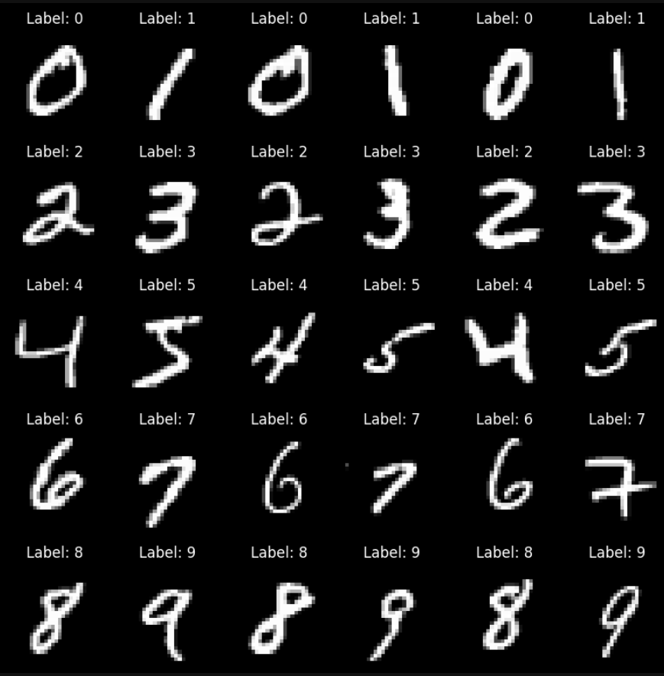
Dataset
Screenshot of the dataset:

Slide 12
Results and Discussion
Methodology (Vanilla SGD):
Baseline Training: A simple neural network trained sequentially on five binary classification tasks from Split-MNIST.
Optimization: Used Stochastic Gradient Descent (SGD) with cross-entropy loss and a learning rate of 0.01.
Training Setup: Each task trained for 5 epochs, and after each task, the model was evaluated on all previously learned tasks to measure forgetting.
Evaluation Metrics: Measured accuracy retention over time to observe the impact of catastrophic forgetting.
Expected Outcome: Performance on previous tasks decreases as new tasks are learned, demonstrating the forgetting effect.

Slide 13
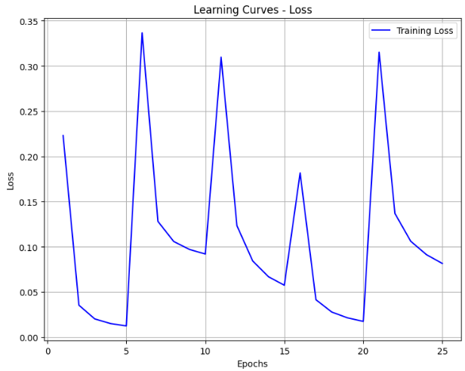
Results and Discussion
The spikes in loss coincide with transitions in training between tasks. The decreases then show how the model adapts to the new task.

Slide 14
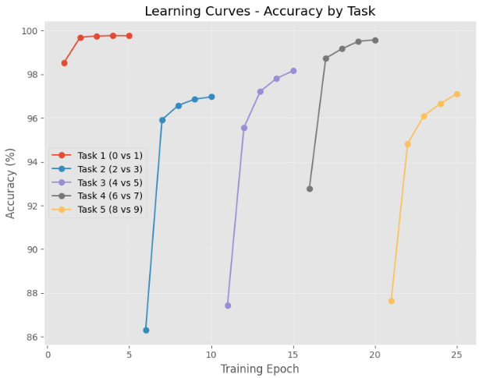
Results and Discussion
The graph shows how the model adapts to learn to classify for the current task. In each case, the model shows strong performance on the current task.

Slide 15
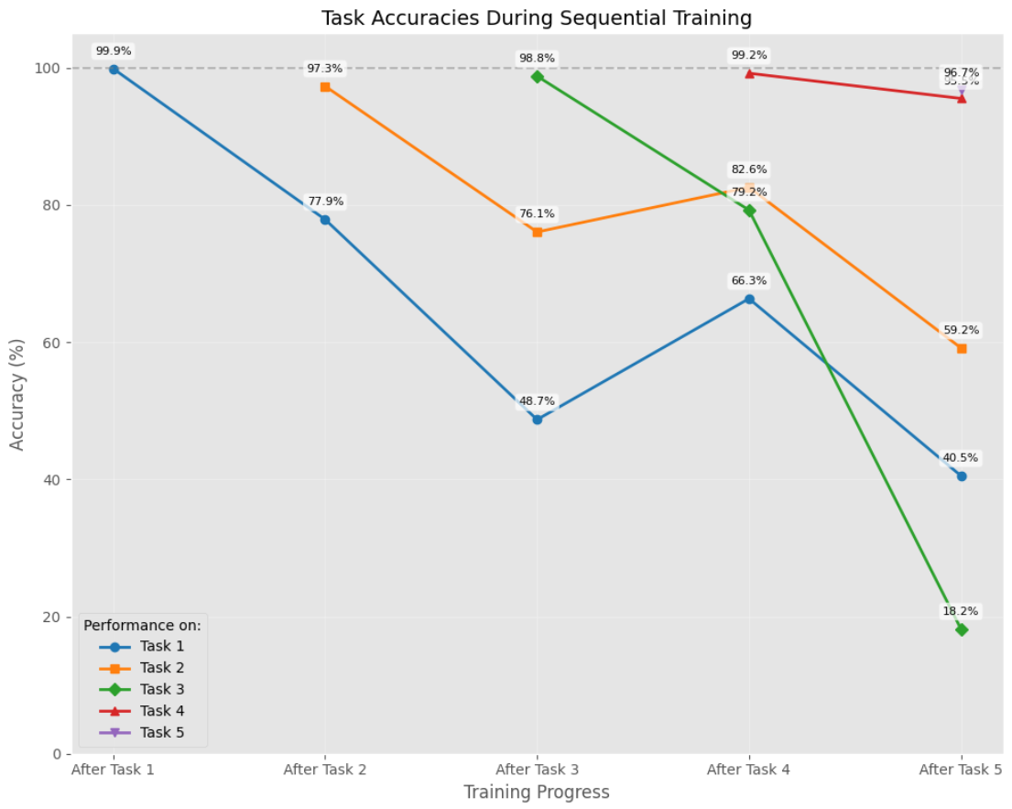
Results and Discussion
In this plot, we can see the effects of forgetting as new tasks as trained. A general downward trend in accuracy is observed after subsequent tasks are trained with a few exceptions of increased accuracy which can be attributed to factors such as positive transfer or randomness.

Slide 16
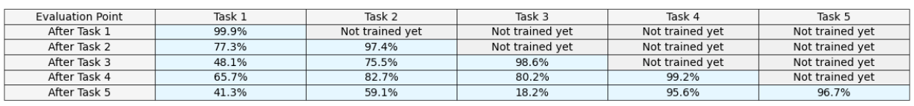
Performance Analysis
Performance Summary

Slide 17
Conclusion
Forgetting Observed: Accuracy on earlier tasks dropped significantly as new tasks were trained, confirming catastrophic forgetting.
Learning Adaptation: The model performed well on the current task, as seen in the accuracy curves.
Fluctuations in Forgetting: Some tasks showed temporary accuracy increases due to positive transfer or random effects.
Final Accuracy Drop: Task 1 accuracy fell from 99.9% to 41.3%, demonstrating severe forgetting in Vanilla SGD.

Slide 18
Future Enhancement
Regularization-Based Methods (EWC, SI):
Modify loss function to penalize drastic weight changes.
Implement Elastic Weight Consolidation (EWC) by storing Fisher Information to protect crucial weights.
Implement Synaptic Intelligence (SI) to track weight importance over time.
Replay-Based Method (Experience Replay):
Store a buffer of past task samples and mix them with new task data.
Modify data loading to sample from both new and stored old data to reinforce past knowledge.
Architectural Method (PackNet - Progressive Neural Networks):
Train & prune weights after each task, freezing important weights to prevent interference.
Allocate new weights for new tasks while keeping earlier knowledge intact.
Modify training pipeline to progressively "pack" multiple tasks into the same network.
Evaluation & Comparison:
Apply all three methods using the existing training framework.
Compare forgetting rates, accuracy retention, and computational efficiency.

Slide 19
References : APA format
Base Paper:
Van de Ven, G. M., & Tolias, A. S. (2019). Three scenarios for continual learning. arXiv preprint arXiv:1904.07734. https://doi.org/10.48550/arXiv.1904.07734
Link to Paper
Paper I:
Wang, L., Zhang, X., Su, H., & Zhu, J. (2024). A comprehensive survey of continual learning: Theory, method and application. IEEE Transactions on Pattern Analysis and Machine Intelligence, 46(8), 5362-5383. https://doi.org/10.1109/TPAMI.2024.3367329
Link to Paper
Paper II:
De Lange, M., Aljundi, R., Masana, M., Parisot, S., Jia, X., Leonardis, A., Slabaugh, G., & Tuytelaars, T. (2022). A continual learning survey: Defying forgetting in classification tasks. IEEE Transactions on Pattern Analysis and Machine Intelligence, 44(7), 3366-3385. https://doi.org/10.1109/TPAMI.2021.3057446
Link to Paper
Paper III:
Lee, C. S., & Lee, A. Y. (2020). Clinical applications of continual learning machine learning. The Lancet Digital Health, 2(6), e279-e281. https://doi.org/10.1016/S2589-7500(20)30102-3
Link to Paper
Paper IV:
Chen, P. H., Wei, W., Hsieh, C.-j., & Dai, B. (2021). Overcoming catastrophic forgetting by generative regularization. arXiv preprint arXiv:1912.01238. https://doi.org/10.48550/arXiv.1912.01238
Link to Paper

